Slide 1

Computer Science and Engineering Department Semester 4th INTERIOR design application Project BY
OM BHESANIA -D21DCS158
Bhaktesh patel -D21DCS159
NEEL PATEL-D21DCS167

Slide 2
contents
Project definition
OBJECTIVES OF PROJECT
SCOPE OF THE PROJECT
HARDWARE AND SOFTWARE
TECHNOLOGY OVERVIEW
USE-CASE DIAGRAM
Activity diagram
ADVANTAGES
LIMITATIONS
snapshots
references

Slide 3
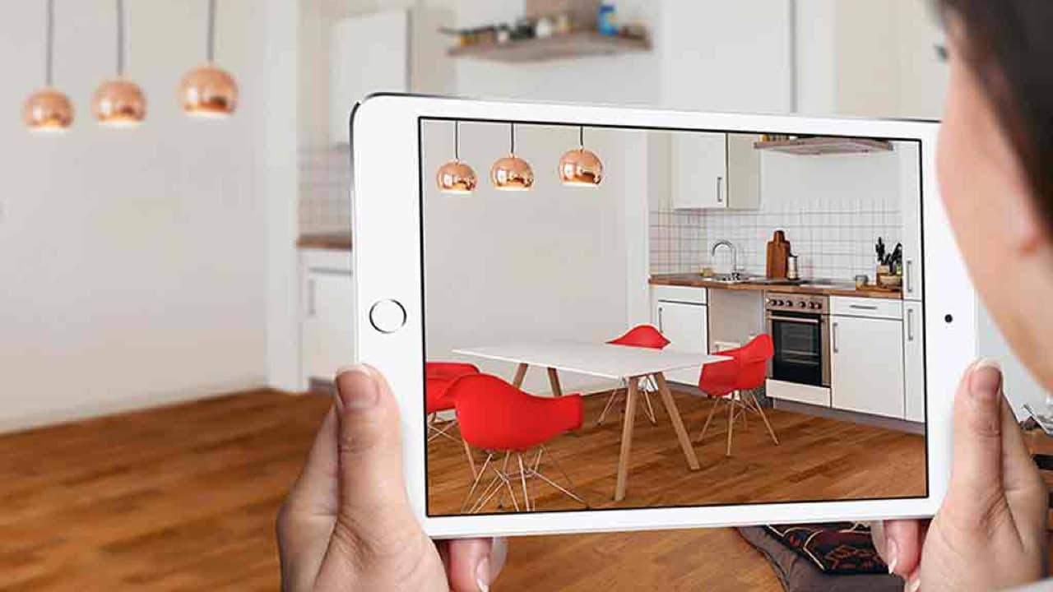
Project definition
It is an application which helps a user to decorate his/her house using our ar application

Slide 4
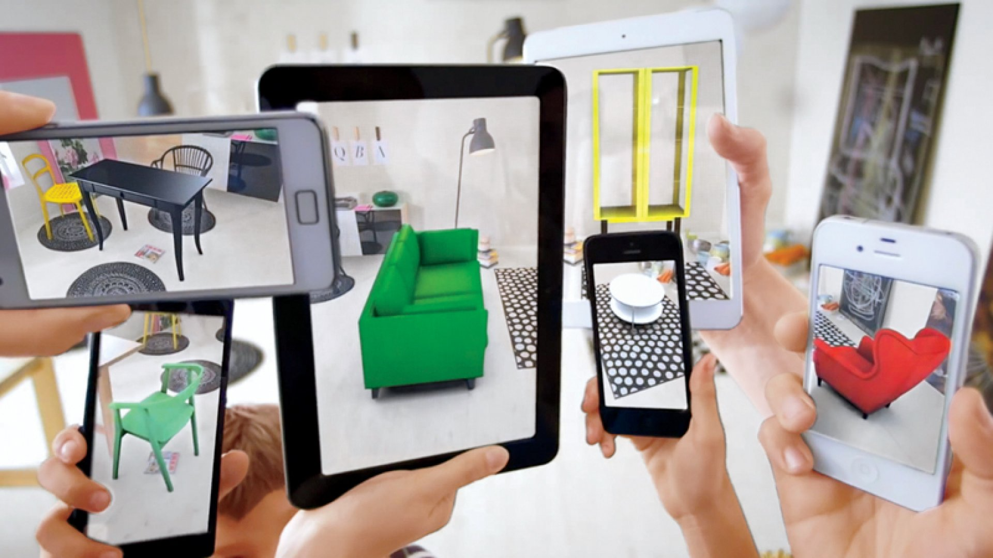
OBJECTIVES OF PROJECT
To create an interior design application using augmented reality technology,To provide users a new interactive technology

Slide 5
SCOPE OF THE PROJECT
User — Everybody that has mobile gadget to use the augmented reality application to design their room or house with virtual 3D objects.
Furnishing companies — Implement augmented reality application with virtual 3D representation furniture and furnishings for their customer.
Interaction technique — Three types of gestures have been provided in this application such as drag, pinch and rotation gesture.
Content application — The application is an interactive AR application. The model focus is the furniture of the living room. So, the 3D models that develop will be the furniture of the living room.

Slide 6
HARDWARE AND SOFTWare
HARDWARE REQUIREMENTS:
Android Phone with nougut or higher version.
Processor : i3 or above
Hard disk space: 50 GB
Ram Memory:2 GB
SOFTWARE REQUIREMENT:
Windows 10
Android Studio
Unity 3D
OPERATING SYSTEM:
Windows 7, Windows 8, Windows 10.
The Developed project can be run on any of the above operating system

Slide 7
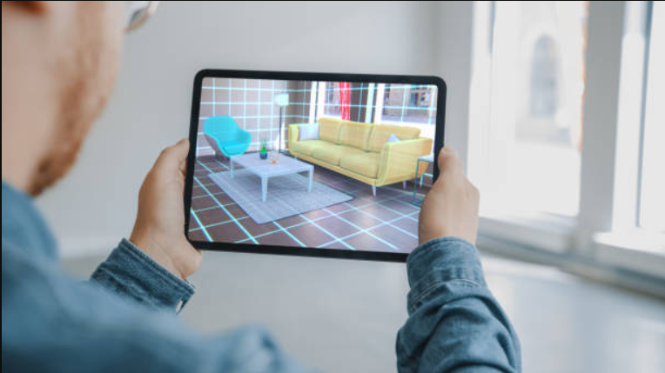
TECHNOLOGY OVERVIEW
The Augmented Reality Technique has become a hot issue in the field of computer vision technology, with its different user experience.
The study on Augmented Reality Technique is mainly divided into two directions, one is implementing camera 3D registration by identifying the markers in scene, the other is updating camera pose by doing3D reconstruction to the unknown scene, rendering the virtual objects in real-time.

Slide 8
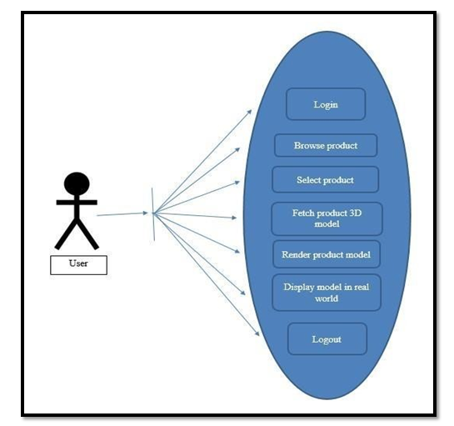
USE-CASE DIAGRAM

Slide 9
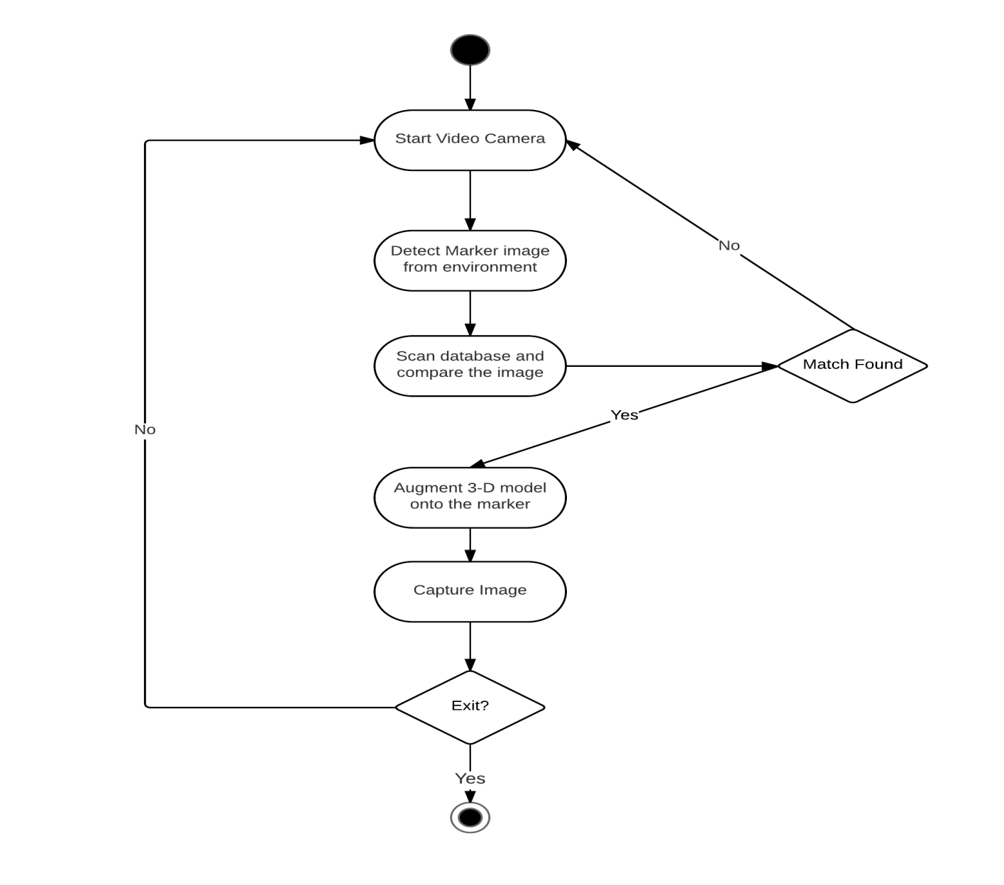
Activity diagram

Slide 10
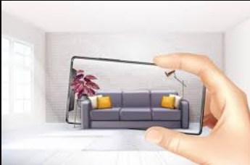
ADVANTAGES
Better Visualization
Design editing abilities
Better guidance
Find and try products remotely

Slide 11
. LIMITATIONS
AR Technology is not widely supported in all android devices , so to overcome the issue 8th wall was used, as 8th wall is still a developing arsdk tool, hence the lack of accuracy in the application is faced.
The application unable the user to place two or more instances of object on a single surface due to limited features provided by the sdk tool.

Slide 12
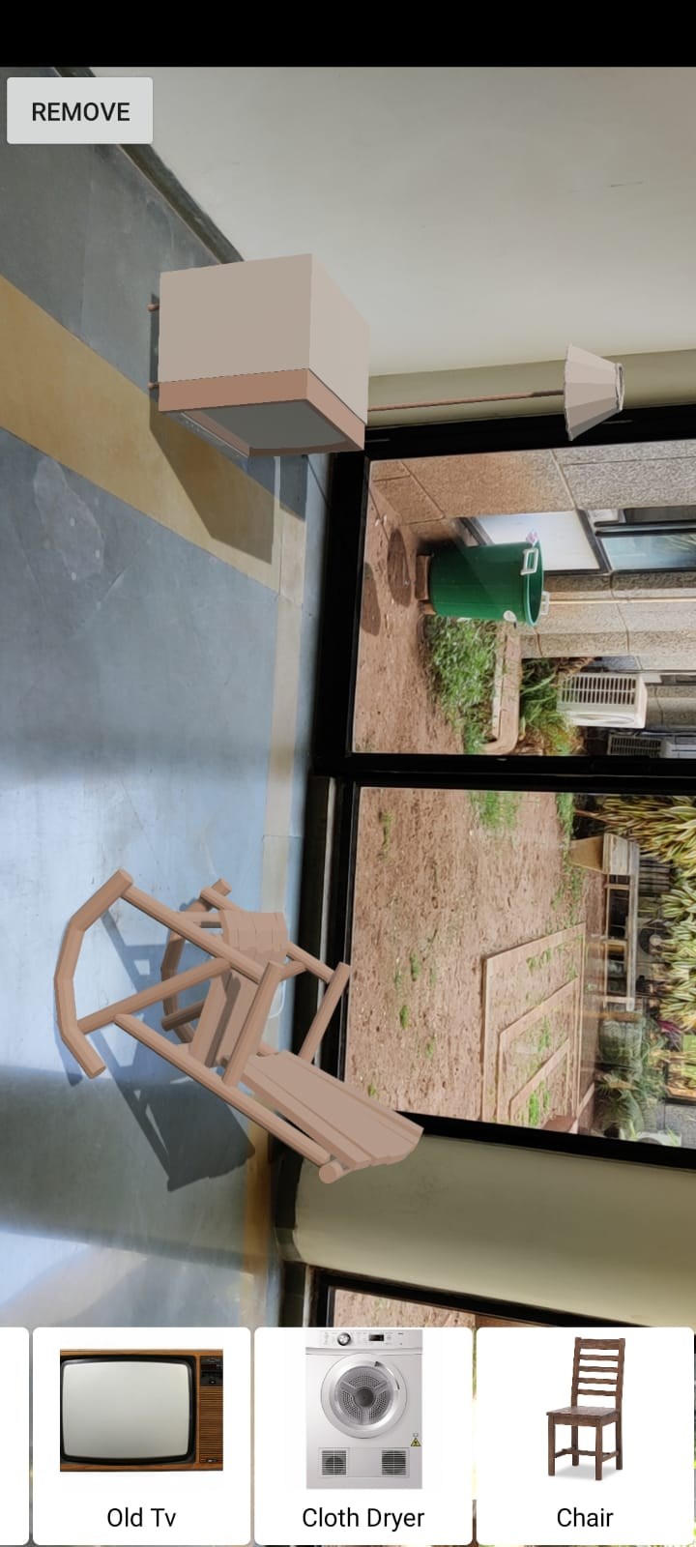
SNAPSHOTS of our application

Slide 13
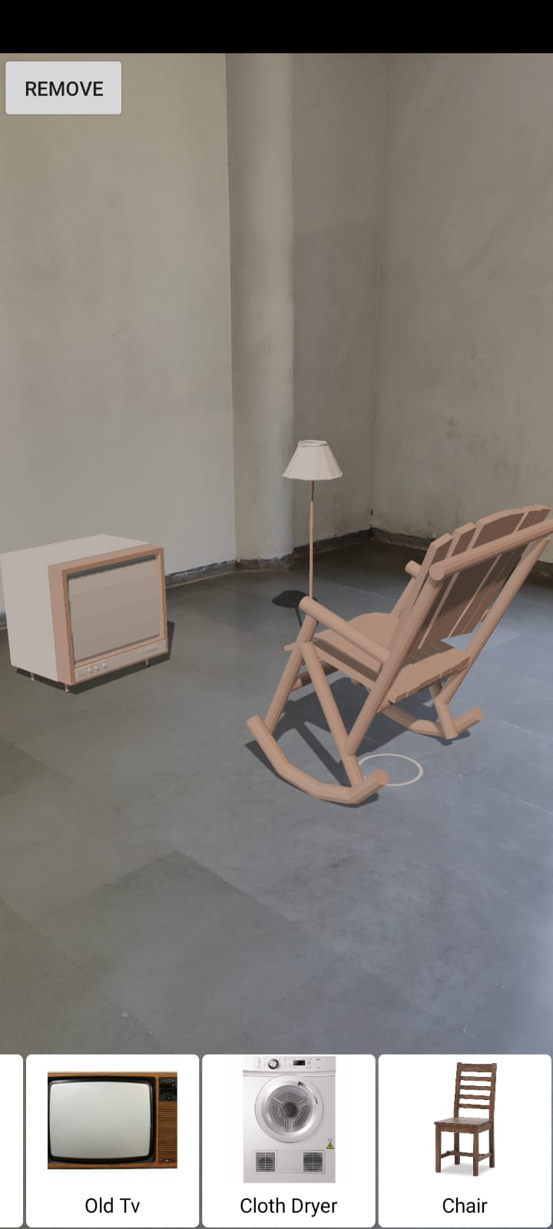
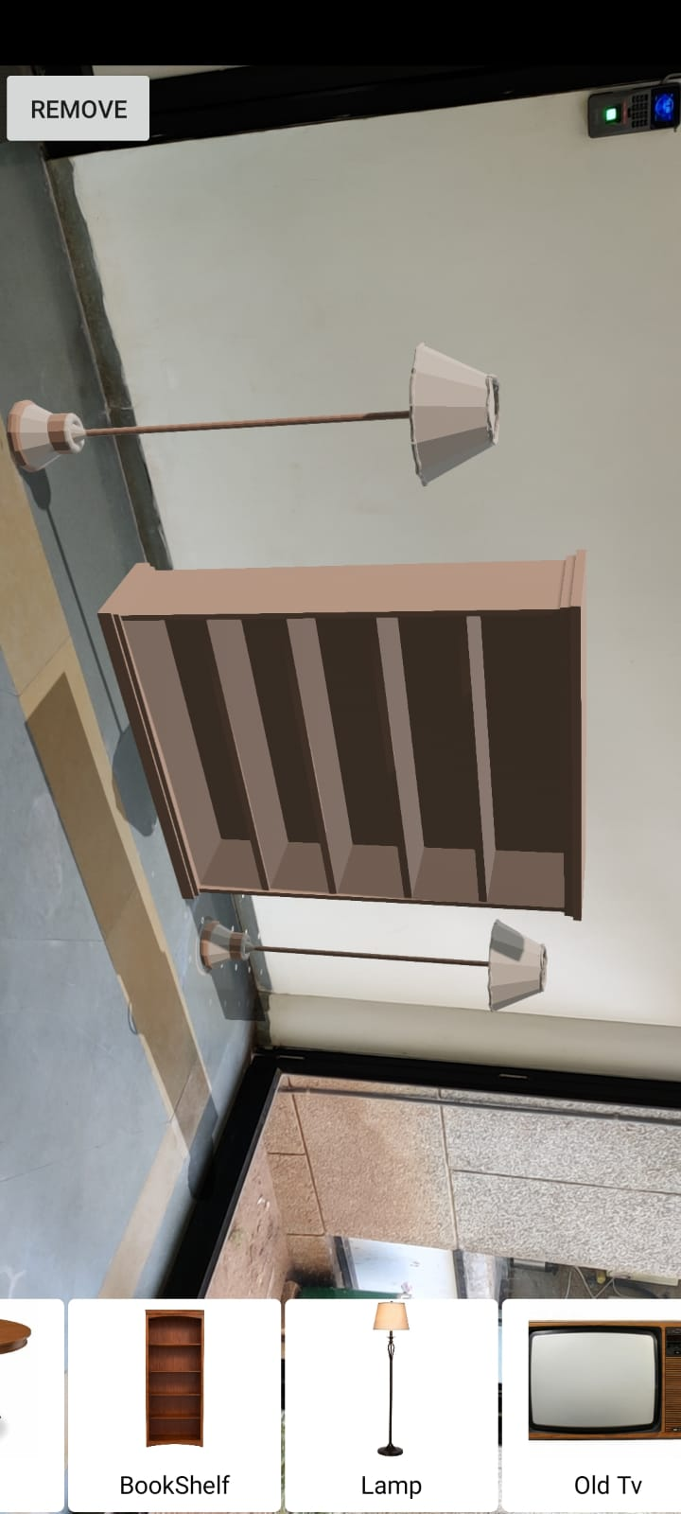

Slide 14
references
https://developer.ibm.com/patterns/augmented-reality-android-mobile-app-interior-decorator/
https://www.scnsoft.com/augmented-reality/interior-design
https://youtu.be/YSUpB3z8NHc
https://www.queppelin.com/augmented-reality-ar-in-interior-designing/#:~:text=Advantages%20of%20Augmented%20Reality%20in,space%20the%20way%20they%20want

Slide 15
Thank you

